Slide 1
Chapter Fourteen
How Private Are Web Communications

Slide 2
URLs
Some URLs contain information after ‘?’s
More typically, information is sent via put’s or post’s
Can send more information, especially with post’s

Slide 3
Request Information
Source and destination IP addresses
The operating system
The browser and version
A reference if you followed a link
Only source and destination if you use HTTPS

Slide 4
Available to Server
Because server receives request it has all information
Often used to track your browsing
Find which pages are most popular
Find how people navigate site
Logs keep track of all users
Once logs are created, can be used for a variety of purposes other than original

Slide 5
Cookies
Small amount of site-specific information stored in your browser
Used to keep track of you and your preferences at various sites
Should be a random set of letters and number that associates you with your previous visits
Server sends and browser stores and sends

Slide 6
Attributes
Name=Value; …
Domain and path
To limit cookie to single domain or part of domain
Expires and Max-Age
When the browser can delete
If no date, session cookie

Slide 7
Attributes
Secure
For secure communication only
HTTPOnly
Do not allow other methods, such as JavaScript, to access

Slide 8
Server and Browser
[Server]
HTTP/1.0 200 OK
Content-type: text/html
Set-Cookie: theme=light
Set-Cookie: sessionToken=abc123; Expires=Wed, 09 Jun 2021 10:18:14 GMT
[Browser]
GET / HTTP/1.1
Host: www.example.org
Cookie: theme=light; sessionToken=abc123

Slide 9
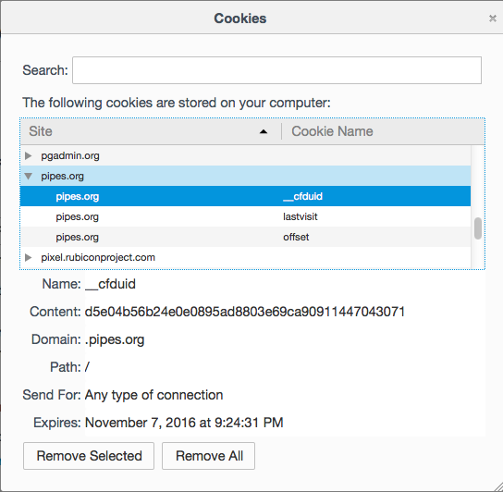
Cookie Jar

Slide 10
Upsides and Downsides
Upside: sites can keep track of you and your preferences
Downside: sites can keep track of you and your preferences
Difficult to pick and choose
Difficult to know when a cookie is innocuous

Slide 11
Third-Party Cookies
Many web sites have 1x1 character pixels from other sites
Other site able to send

Slide 12
www.google.com
<img alt='Electronics Holiday Gift Guide' src='http://g-ecx.images-amazon.com/images/G/01/x-locale/common/transparent-pixel._V386942464_.gif’ […]

Slide 13
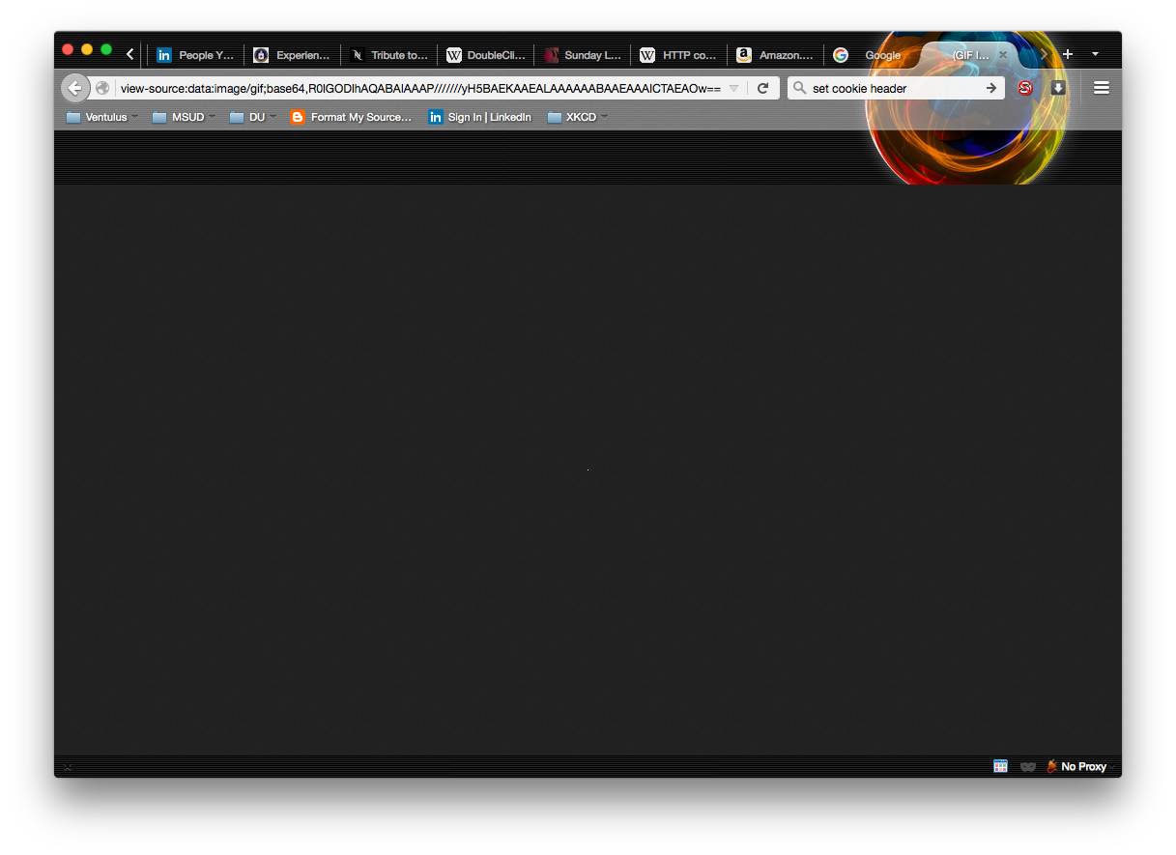

Slide 14
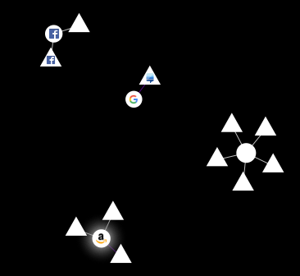
Lightbeam Connections

Slide 15
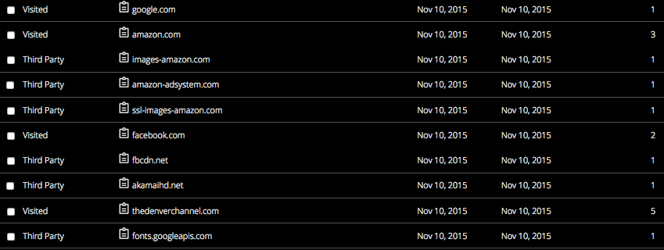
LightBeam List

Slide 16
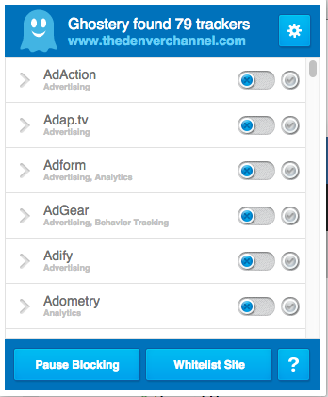
Ghostery

Slide 17
Defenses
AdBlock
NoScript
https://www.eff.org/privacybadger
Do Not Track
Voluntary
Delete cookies and history on close
Private browsing

Slide 18
Strongest Defense
Tor

Slide 19
Work Computers
You have probably signed an agreement that all the data on your computer is owned by the company
It has the right to examine all of it
A few have “fair” or “limited use” clauses

Slide 20
Computer Repairs
Technicians have access to everything too
Might mistakenly stumble across personal information
Encrypt everything that you can
BitLocker
FileVault

Slide 21
Online Credit Card Transactions
Can be difficult to address as there is no nearby brick and mortar store
Especially if in different country
CC companies typically very good at detecting fraud
Also good at refunding fraudulent transactions

Slide 22
Online Credit Card Transactions
Your info on remote server
If you allow them to keep your info
And in any case, while the transaction is being cleared
However, it could be information not sent to site but only to processor
Any computer with CC info on must pass PCI DSS

Slide 23
The Payment Card Industry Data Security Standard
Build and maintain a secure network
Install and maintain a firewall configuration to protect cardholder data
Do not use vendor-supplied defaults for system passwords and other security parameters
Protect cardholder data
Protect stored cardholder data
Encrypt transmission of cardholder data across open, public networks
Notes:
https://en.wikipedia.org/wiki/Payment_Card_Industry_Data_Security_Standard

Slide 24
The Payment Card Industry Data Security Standard
Maintain a vulnerability management program
Use and regularly update anti-virus software on all systems commonly affected by malware
Develop and maintain secure systems and applications
Implement strong access control measures
Restrict access to cardholder data by business need-to-know
Assign a unique ID to each person with computer access
Restrict physical access to cardholder data

Slide 25
The Payment Card Industry Data Security Standard
Regularly monitor and test networks
Track and monitor all access to network resources and cardholder data
Regularly test security systems and processes
Maintain an information security policy
Maintain a policy that addresses information security

Slide 26
CC Recommendations
Don’t store on site
Keep in password safe
Monitor charges
Possibly use one-time CC numbers if available
Generally, only responsible for $50 if lost
And reported

Slide 27
Data Mining and Aggregation
There is a lot of information on you at various sites
There are businesses that combine (aggregate) the information to create a detailed profile of you
Very valuable to retailers
E.g.: Target knew a girl was pregnant before her family
Notes:
http://www.forbes.com/sites/kashmirhill/2012/02/16/how-target-figured-out-a-teen-girl-was-pregnant-before-her-father-did/

Slide 28
Data Mining and Aggregation
Be very careful what you post
Don’t tell the world you’re going on a vacation
Or where you are all the time
Remove location information from pictures you post

Slide 29
Sniffing Packets
Essentially, all packets on the Internet can be examined by pretty much anyone
Cannot rely on physical media not being compromised
Must use encrypted transmission
Wireshark a very popular tool

Slide 30
Don’t Install Toolbars
Ask! a classic example
Toolbars and plugins can monitor what you are typing, where you are going, etc.
Often “side-along” installs

Slide 31
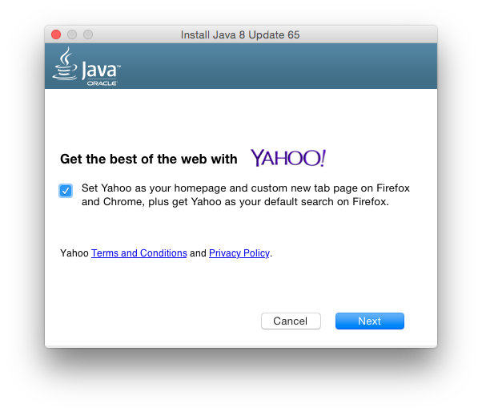
Oracle Lameness

Slide 32
Remembrance of Forms Past
Browsers keep information you’ve used before
When compromise occurs, sent out

Slide 33
sqlite3 -list formhistory.sqlite .dump
INSERT INTO "moz_formhistory" VALUES(1,'searchbar-history','zoom2' [...]
INSERT INTO "moz_formhistory" VALUES(2,'searchbar-history','keypassx' [...]
INSERT INTO "moz_formhistory" VALUES(3,'email','drsjb80@gmail.com' [...]INSERT INTO "moz_formhistory" VALUES(4,'searchbar-history','jumpcut' [...]

Slide 34
sqlite3 -list formhistory.sqlite .dump
INSERT INTO "moz_formhistory" VALUES(545,'new_password', [...]
INSERT INTO "moz_formhistory" VALUES(546,'fld_username', [...]

Slide 35
How Your Data May Be Released
You do it voluntarily
Spyware you install
Vulnerability exploited

Slide 36
You Do It Voluntarily
Your social media
Will be compromised
You click in email
Reputable companies will never ask for sensitive information via email
You enter information in a form

Slide 37
Spyware
You install it with other downloads
You believe you’re getting something for free
Don’t click on email attachments in general
Download from known-good sources
Even then, they may be compromised
App stores contain malware
AV can help
Sophos and Windows Defender

Slide 38
Security Vulnerabilities
Keep up to date on patching
Don’t use software you don’t need
Including browser plugins
Make sure you’ve disabled Java
http://java.com/en/download/help/disable_browser.xml
Try not to use flash and keep it updated

Slide 39
Questions
Discussion: 1, 4, 5, 6, 7
Exercises: 9

